Slide 1


Chat Application POC
Ravi Kumar

Slide 2

Introduction
Birds of similar feather flock together.
And
People of same likings CHAT with each other.

Slide 3

Application Goals
Create a chat application for 10,000 people.
These people will be distributed across
different chat rooms.
Chat rooms can be designated with different titles such as sports, drama, movie etc.
People will be given flexibility to move across
different chat rooms.
People will be given recommendations to move to different chat rooms based on their quantitative chat reports.
Size and number of chat rooms will be flexible.

Slide 4
Functional Assumptions: Any machine however smart, needs data to function smartly.
1. Out of 10,000, at least 1000 people will be asked to
fill in a form, where
They will mention only three things about themselves
i.e. age, sex, and sexual orientation.
They will mention multiple choices about their partner's
likings. For ex- movie, hobby, education, sexual orientation,
tourist destinations etc.
Based on these people will give their assumption as likelihood
of their partnership in the binomial form of 1 or 0.
2. Out 1000; 5 group of 200 people each will be generated, by taking
the commonality of movie, hobby, sexual orientation to start with.
3. Next incoming 9000 people will be distributed in these groups
based on classification based machined learning algorithms.

Slide 5

Technical Goals
People will be distributed across different chat rooms.
People will be given flexibility to move across different chat rooms.
People will be given recommendations to move to different chat rooms based on their quantitative chat reports.
Size and number of chat rooms will be flexible.
Based on quantitative study of individual/ groups, they will be recommended to move to different for different chat rooms.

Slide 6

Data
I have created manually an assumed data with 1096 entries.
Data is all manually assembled; it doesn’t have any resemblance to actuality.
Data is only for Demo purpose.

Slide 7
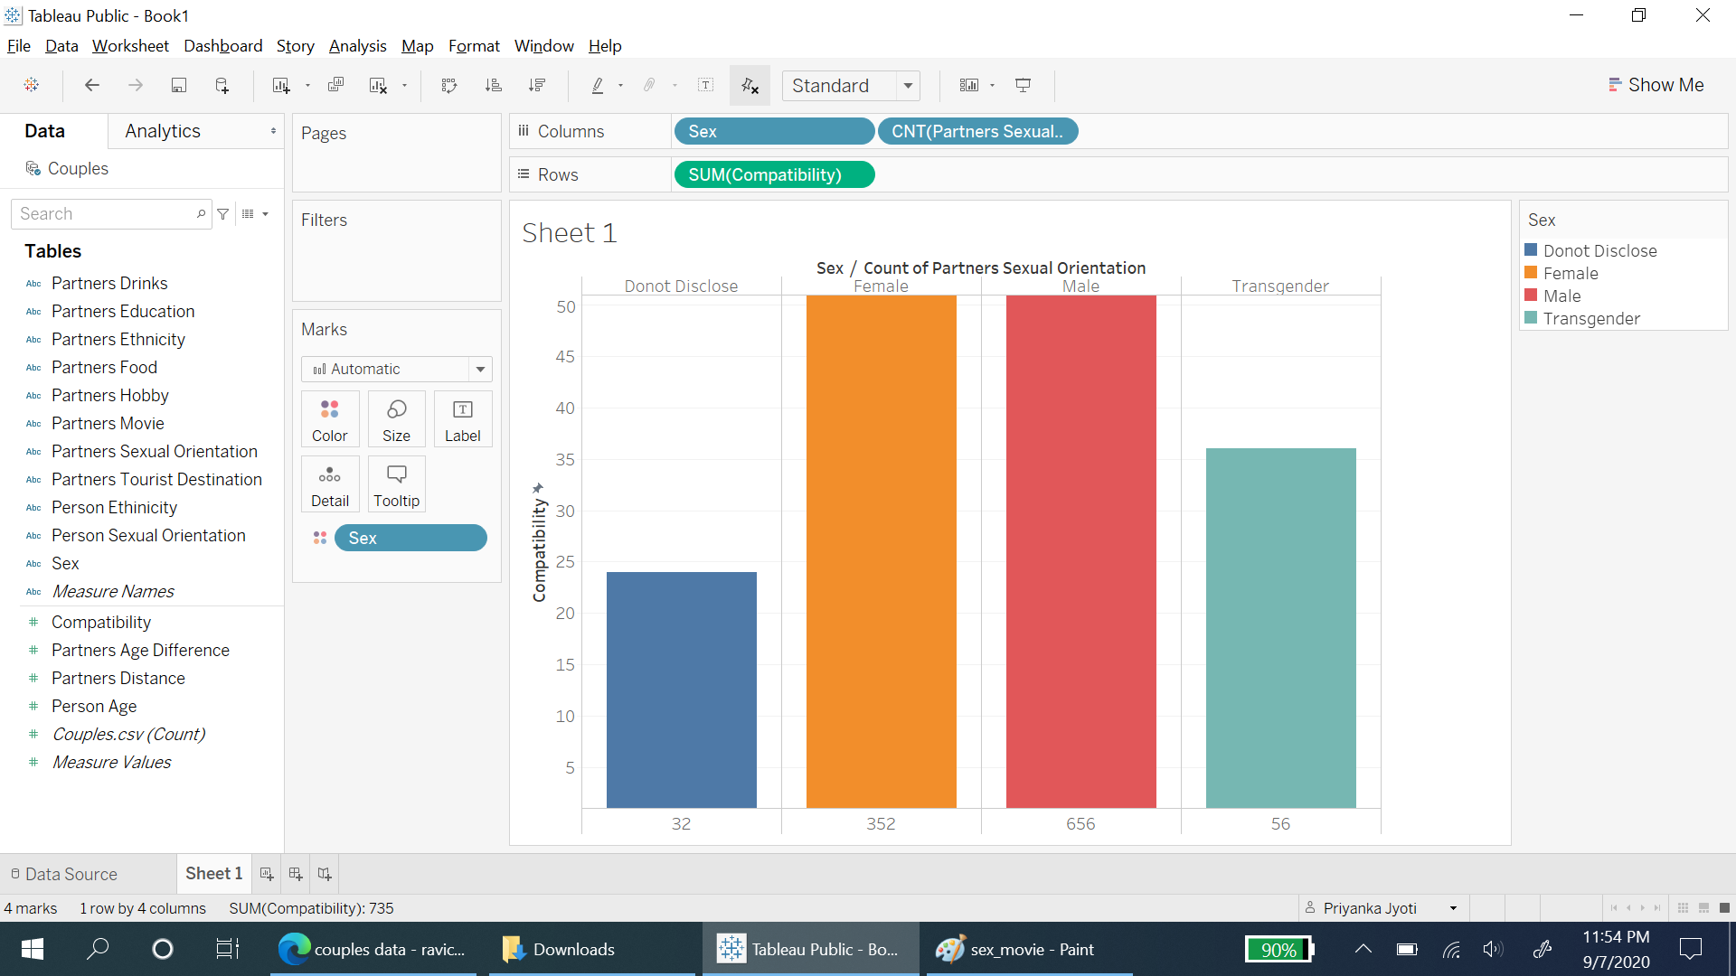
Tableau Reports - 1
Male and female are equally inclined to compatibility.
Transgenders are also showing positive inclination.

Slide 8
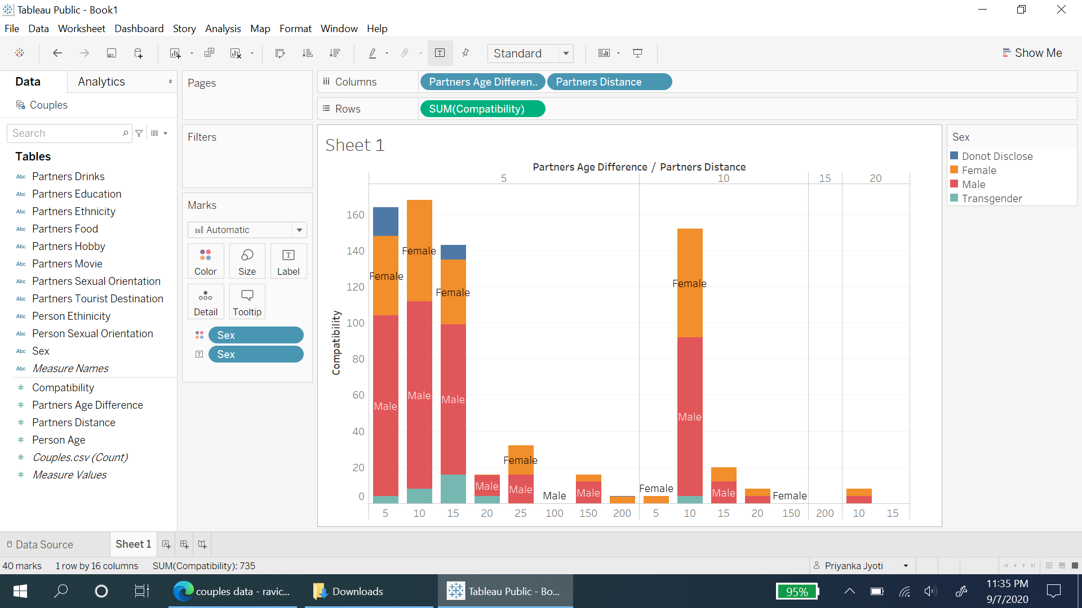

Tableau Report -2
Both male and female are preferring their partners to stay less than 15 miles.
Long distance relationships are showing negative trends as only one female is expecting her partner to be located around 150 miles.

Slide 9
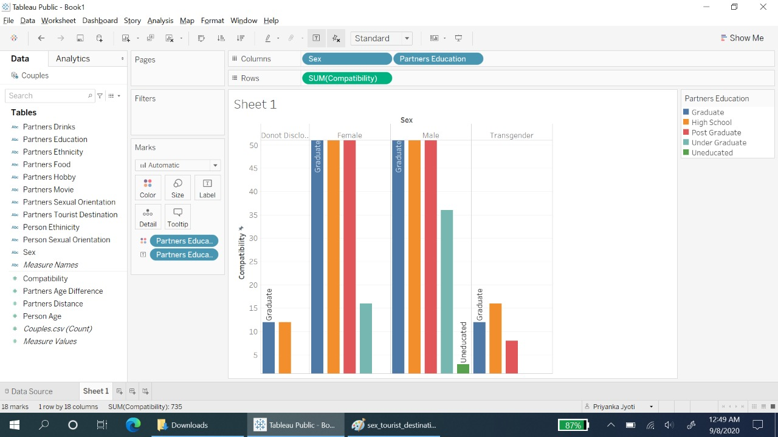
Tableau Report -3
All the genders are refraining from uneducated partners.

Slide 10
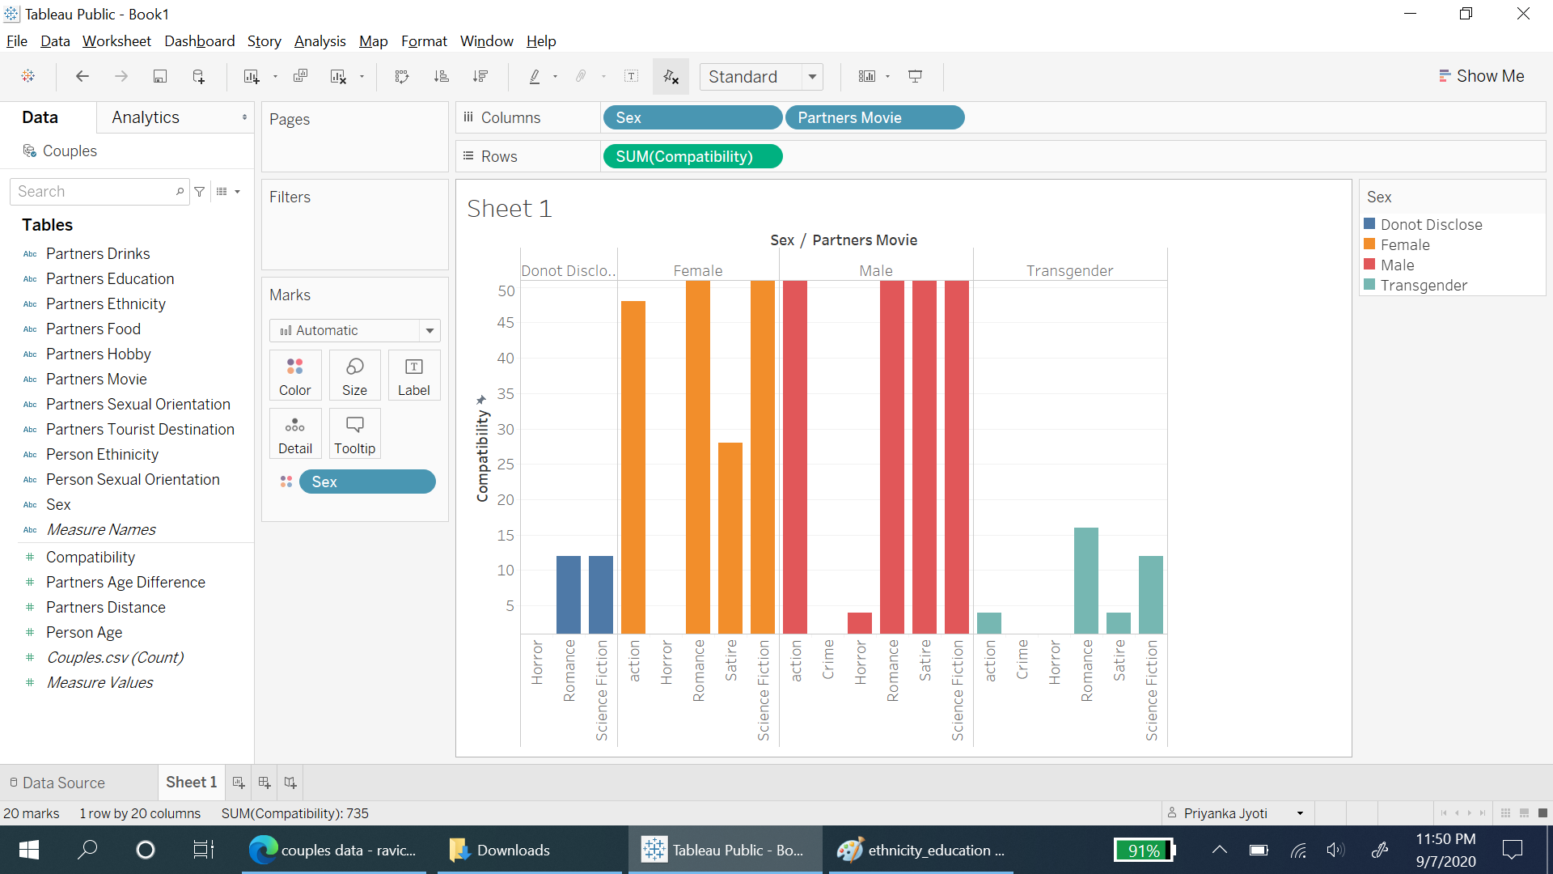
Tableau Report - 4
Both male and female are expecting their partners not to watch Horror movies.

Slide 11
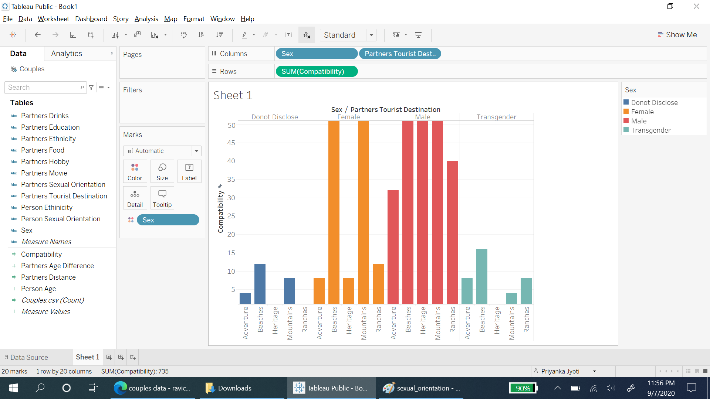
Tableau Report - 5
Both male and female expect their partners to like mountains and beaches as tourist destination.

Slide 12
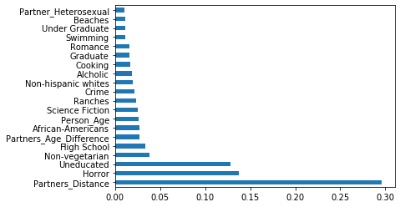
Feature Importance - ExtraTreesClassifier()
The top 20 variables affecting the compatibility are calculated.
This is calculated using ExtraTreesClassifier()
The tableau report is conforming with the model.

Slide 13
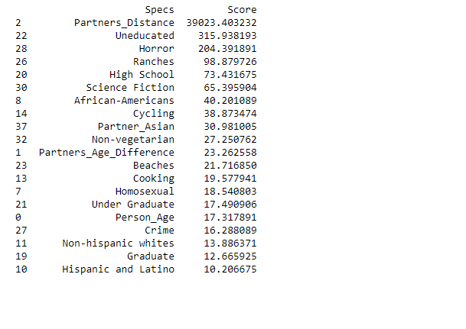
Feature Importance - apply SelectKBest class to extract top 20 best features
The top 20 variables affecting the compatibility are calculated.
This is calculated using ExtraTreesClassifier()
The tableau report is conforming with the model.

Slide 14

Logistic Regression classification Model
Logistic Regression Classifier
For continuous variables like Person_Age, Partners_Distance , Partners_Age_Difference
For categorical variables like Partners_Hobby, Person_Sexual_Orientation
Variables used as it is.
One hot encoding used to get categorical variables.
(Predicted Probabilities of Class 0, and 1 through Classifier)
Merging all variables and running the logistic regression gives model score which represents the accuracy of the prediction.

Slide 15
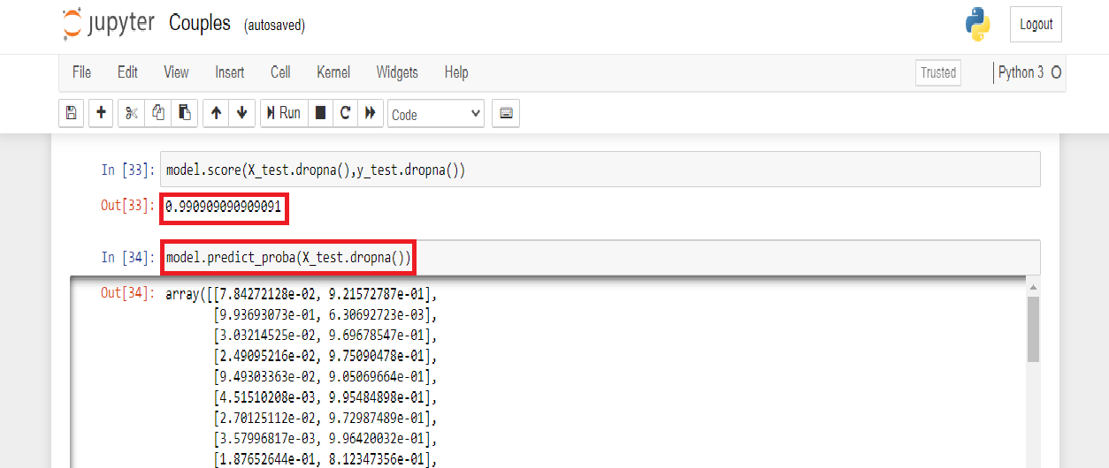
Logistic Regression- Model Performance
In the first run, all the variables are used then accuracy is calculated.
Accuracy = 0.99
Accuracy is coming as 99%.

Slide 16
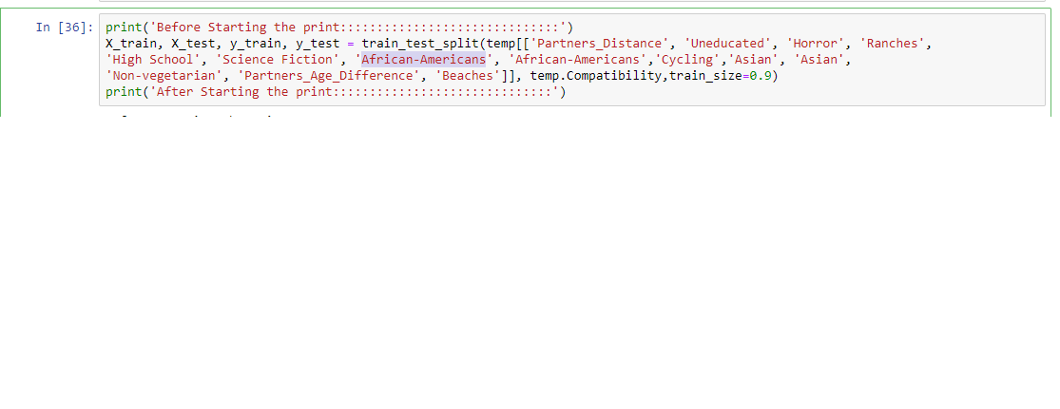
Logistic Regression- Model Performance with selected features only.
Taking the commonality between ExtraTreesClassifier() and SelectKBest below variables are considered significant
Partners_Distance, Uneducated, Horror, Ranches, High School, Science Fiction etc.
Accuracy = 0.99
Accuracy is coming as 99%.

Slide 17

Conclusion
Prediction accuracy is same whether by using all the variables or the variables deduced by feature engineering.
Using lesser feature, and getting accuracy more than 80% will create a right trade off between computation and accuracy.

Slide 18
Conclusion - Contd
When the basic modeling is done. First 1000 users should be encouraged to fill preference about their partners and tell about compatibility.
Based on the learning the other 9000 users should be churned to join groups of similar likings.
The probable compatibility of each user should be tested against the group.

Slide 19

Recommendations
A trigger should be run periodically to check which all the users are not active.
Lesser active users should be given recommendations to join the group which could have more probability of its liking.
Number of users in each group should be less than 50, so that people get more chance to switch groups of their choices.

Slide 20
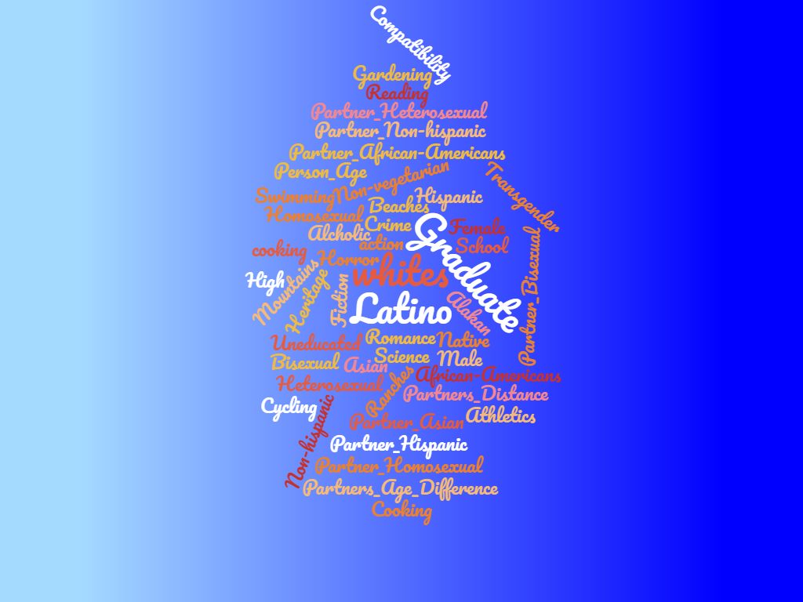
Recommendations – Cont.
A quantitative checks should be run across users, to check their activity.
This could be done by number of words typed per hour or last login time etc.
While filling up the form, users can be encouraged to write about their expected partners. Using NLP and Word Cloud, it will become easier to settle the user to a group of its liking.
We could use different classifier algorithms like Random Forest, KNN.
Use K-fold cross validations to choose the best result.

Slide 21


